Slide 1
Capstone Project - The Battle of Neighborhoods
Selecting the best location to open an SUSHI BAR IN Toronto, Canada
Ying
Coursera applied Data Science Capstone

Slide 2
CONT ENTS
Introduction
Business Problem
Data
Analysis
Results and Discussion
Conclusion

Slide 3
Introduction
Toronto is the provincial capital of Ontario and the most populous city in Canada. Toronto is an international centre of business, finance, arts, and culture, and is recognized as one of the most multicultural and cosmopolitan cities in the world. The diverse population of Toronto reflects its current and historical role as an important destination for immigrants to Canada. More than 50 percent of residents belong to a visible minority population group, and over 200 distinct ethnic origins are represented among its inhabitants. While the majority of Torontonians speak English as their primary language, over 160 languages are spoken in the city. The insights derived from analysis will give good understanding of the business environment which help in strategically targeting the market. This will help in reduction of risk of starting a new business. And the Return on Investment will be reasonable.

Slide 4
Business Problem
The cuisine of Toronto reflects Toronto's size and multicultural diversity. Let’s say one of my friends, Lily, wants to open a sushi restaurant in Toronto. Starting a sushi restaurant can be a great business opportunity.
New sushi bar should be open in an area that inadequate neighborhood in this way the bar can attract more customers. Therefore, this analysis necessary to ensure that we have enough customers and that we are not so close to other sushi places.

Slide 5
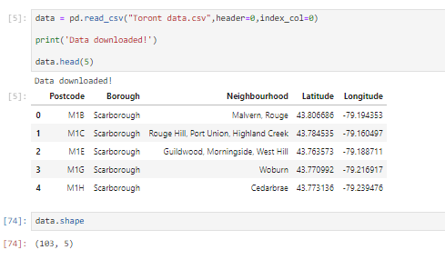
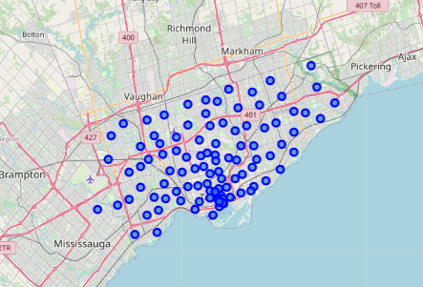
Data
Neighborhood has a total of 10 boroughs and 103 neighborhoods. In order to segement the neighborhoods and explore them, we will essentially need a dataset that contains the 5 boroughs and the neighborhoods that exist in each borough as well as the the latitude and logitude coordinates of each neighborhood. The data is from our week3 assignment, I will export the data as csv file for future analysis.

Slide 6
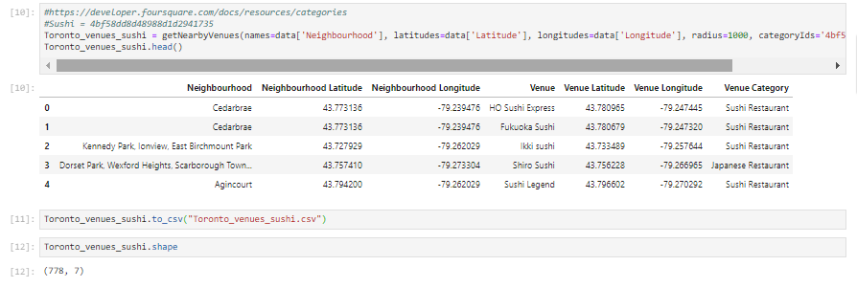
Data
Now once we got the neighborhood's latitude and longitude, let's use Foursquare Location to get the Mission District Neighborhood's all restaurant details. The restaurant details can be retrieved using search endpoint. Sushi category Id 4bf58dd8d48988d1d2941735 is used for retrieving data from Foursquare API.

Slide 7
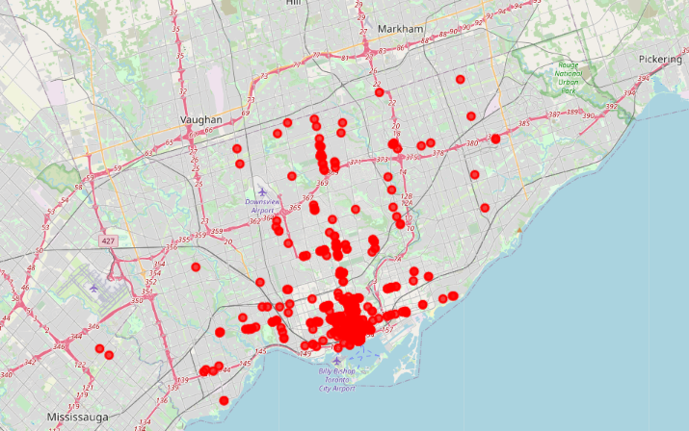
Analysis
Sushi restaurant in Toront

Slide 8
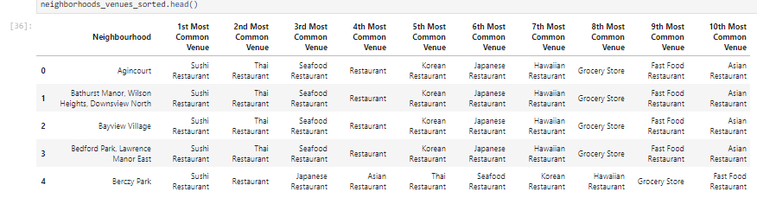
Analysis
All sushi restaurants are grouped by neighborhoods and analyzed based on categories.

Slide 9
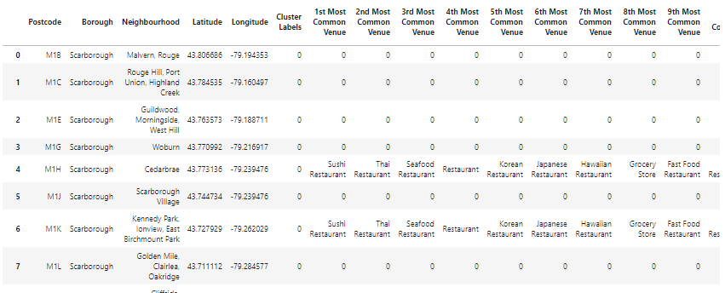
Analysis
The neighborhoods are grouped into clusters using 1st common venue. K-means clustering algorithm will be use to complete this task.

Slide 10
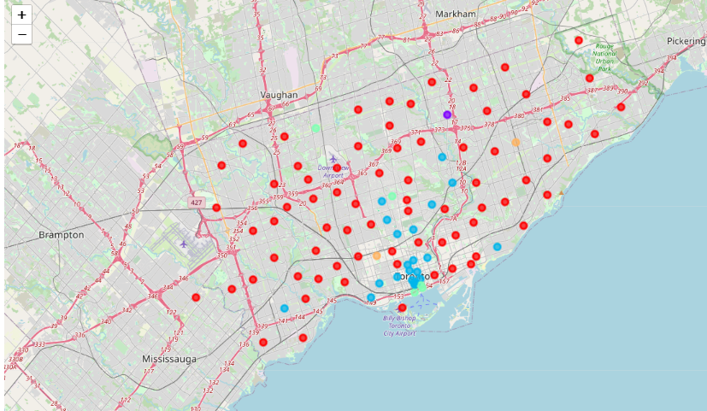
Analysis
The Folium library to visualize the neighborhoods in Torontos and its emerging clusters.

Slide 11
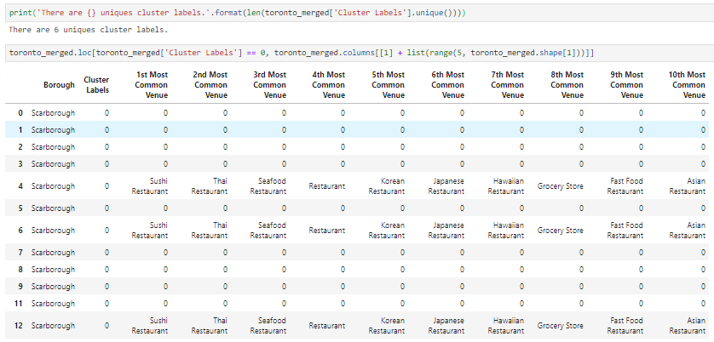
Results
Using K-mean to clustering data area with less number of sushi bars.
Cluster 0

Slide 12
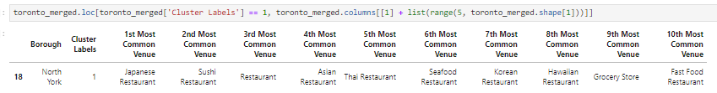
Results
Using K-mean to clustering data area with less number of sushi bars.
Cluster 1

Slide 13
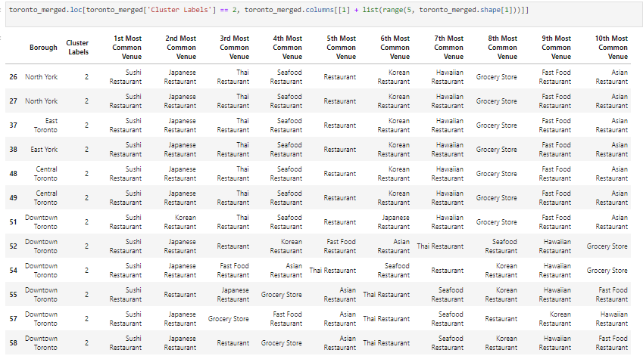
Results
Using K-mean to clustering data area with less number of sushi bars.
Cluster 2

Slide 14
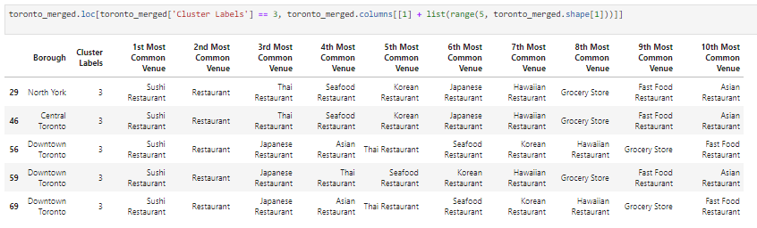
Results
Using K-mean to clustering data area with less number of sushi bars.
Cluster 3

Slide 15
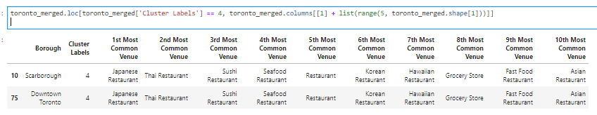
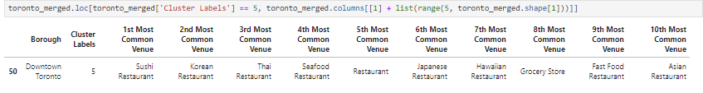
Results
Using K-mean to clustering data area with less number of sushi bars.
Cluster 4
Cluster 5

Slide 16
Discussion
Our analysis shows that although there is a great number of Sushi restaurants in Toronto (~800 in our initial area of interest which was radius 1000 around each neighbourhood), there are pockets of low restaurant density fairly close to city center. Highest concentration of restaurants was detected in downtown Toronto area, so we focused our attention to areas north, north-east, far away from downtown area.
Those location candidates were then clustered to create zones of interest which contain greatest number of location candidates. Purpose of this analysis was to only provide info on areas in Toronto but not crowded with existing restaurants (particularly Sushi) - it is entirely possible that there is a very good reason for small number of restaurants in any of those areas, reasons which would make them unsuitable for a new restaurant regardless of lack of competition in the area. Recommended zones should therefore be considered only as a starting point for more detailed analysis which could eventually result in location which has not only no nearby competition but also other factors taken into account and all other relevant conditions met.

Slide 17
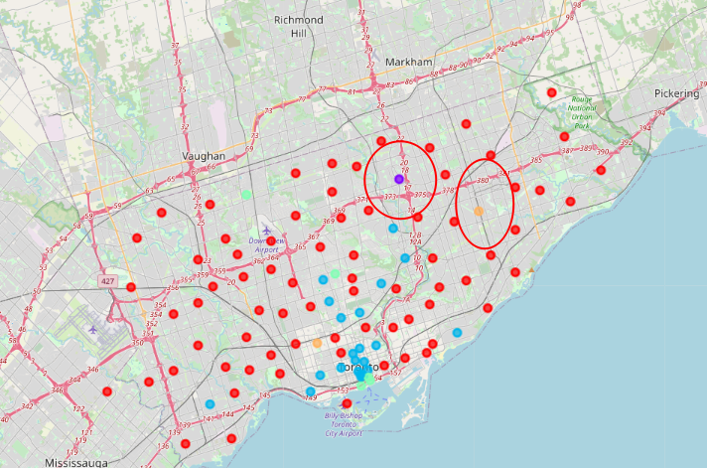
Conclusion
Based on dataframe analysis Cluster 2 (North York) and Cluster 4 (Scaborough Town) areas are good places to open a new sushi bar business.

Slide 18
Conclusion
Final decision on optimal restaurant location will be made by stakeholders based on specific characteristics of neighborhoods and locations in every recommended zone, taking into consideration additional factors like attractiveness of each location (proximity to park or water), levels of noise / proximity to major roads, real estate availability, prices, social and economic dynamics of every neighborhood etc.

Slide 19
Thanks
Ying
April 30, 2020

